Slide 1

BUZZWORD
COMPLIANCE

Slide 2

Buzzword Compliance
3 Slides Per Buzzword
High Signal To Noise
Breadth Over Depth
About EXPLORING Python

Slide 3

Buzzword Compliance
The
Python
Language
Library Building Blocks
(Games & Graphics)
Big Honking Frameworks
(Web Application Frameworks)
All are part of Python

Slide 4
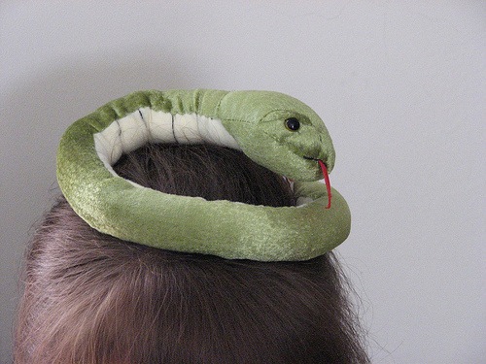
LEARNING
PYTHON

Slide 5
Learning Python
The Quick Reference Sheet
Python Tutorial
Python Challenge
A Cycle of Learning

Slide 6
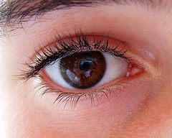
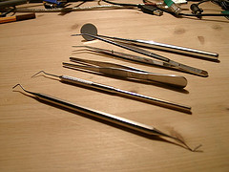
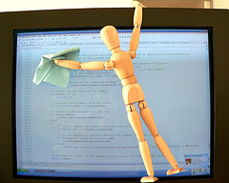
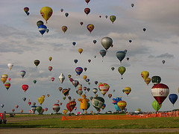
Learning Python
GENERAL READING
USE NEW TOOLS
CODE!
EXPLORE LIBRARIES

Slide 7
[ ]
LIST
COMPREHENSIONS

Slide 8
List Comprehensions
A Cool Idiom of Python
Enables Conciseness
Obviates map, filter, reduce
Unrolls into Simple Loops

Slide 9
List Comprehensions
lost = sum([c.billed - c.paid for c in customers if c.is_deadbeat()])
  l = [ ]
  for c in customers:
  if c.is_deadbeat():
  l.append(c.billed - c.paid)
  lost = sum(l)

Slide 10

EXECUTING
MODULES

Slide 11
Executing Modules
Import runs code, once.
def is just a statement
Use to precalculate stuff
Python just runs scripts in namespaces

Slide 12
Executing Modules
class C:
print “Hello from C”
def help_make_table(size):
...
c_table = help_make_table(64)
del help_make_table

Slide 13
@
DECORATORS

Slide 14
Decorators
Wraps methods with new functionality
Useful for logging, security, etc.
Clean Syntax for use
Unrolls to simple code

Slide 15
Decorators
from decorator import decorator
@decorator
def trace(f, *args, **kw):
print "call %s with args %s, %s" % (f.func_name, args, kw)
return f(*args, **kw)
@trace
def buggy_function(a, b, c)

Slide 16


Slide 17
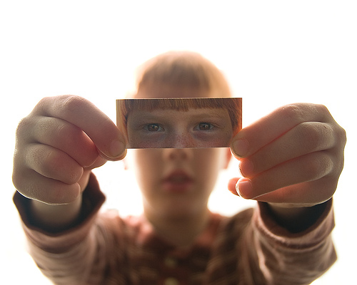
METACLASSES

Slide 18
Metaclasses
The superclass 'type' of classes
Changes functionality of Python
Adds complexity to entire project
Shiny things can be traps

Slide 19
Metaclasses
class Midnight_Hack(type):
def __new__(cls, name, bases, ats):
for a,v in ats.items():
# post-process ats...
return type.__new__(cls, name, bases,ats)
class Innocent_PEP_3115(P3000):
__metaclass__ = Midnight_Hack

Slide 20
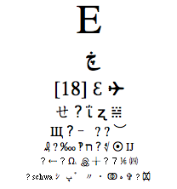
UNICODE

Slide 21
Unicode
Represents every human language
Breaks all ASCII rules
Designed by Committee
Real world adds constraints

Slide 22
Unicode
UNICODE: Universal Character Set; The Unicode Standard book; character
encodings; enumerate properties; text normalization; decomposition;
collation; bidirectional display order; Unicode Consortium; Ligatures; orthographic rules; sidebearing; macron; WGL-4; Multilingual European Subsets MES-1/2/3a/3b;
replacement character; LastResort font; UTF-8; codec.open(); ISO 14755;
C0 and C1 control codes; Han unification versus TRON; GB-18030;
Binary Ordered Compression; Basic Multilingual Plane; UnicodeDecoderError on
str.encode() contrasted with UnicodeEncoderError on str.decode(); endianness
external metada ta; PunyCode; graphemes; syllabaries; ConScript Unicode Registry;
Universal Transformation Format versus Universal Character Set mappings; Private
Use Area; Hangul Jamo; radicals
Just “make peace” with Unicode

Slide 23
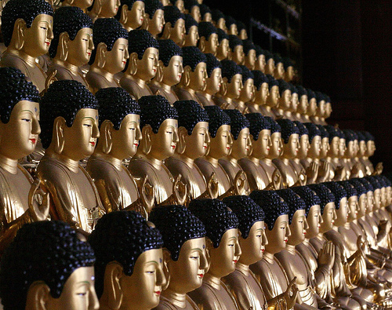
PYTHON
3000

Slide 24
Python 3000
Incremental not Revolutionary
Need to read old code
Available as Alpha (3.02a)
Guido exercises restraint

Slide 25
Python 3000
Function Annotations PEP-3107
def create_map(x: “in map units”,
y: “in map units”,
walls: “2D boolean array (x by y) with True meaning a wall”,
pixel_width: “number of pixels per map unit”) -> “Graphical PNG map”
def random_map(x: Coord, y: Coord) -> Image:

Slide 26
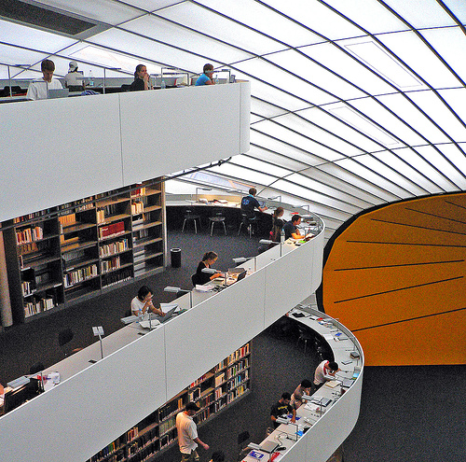
Libraries

Slide 27

Python Imaging Library
(PIL)

Slide 28
Python Imaging Library (PIL)
Reads and Writes Image Formats
Rock solid with 250 formats
Interactive image manipulation
Not all 'batteries included'.

Slide 29
Python Imaging Library
import Image
im = Image.open(“cool.jpg”)
im = im.resize(128,128).rotate(90)
im.save(“cool.png”)
(r,g,b) = im.split()
(x,y) = im.size
im.show()

Slide 30


Slide 31
PyGame
Easy 2D Game Engine
Aggressively cross platform
Continuous contests
Sometimes static != static

Slide 32


Slide 33


Slide 34
Soya 3D
Full 3D Game Engine (almost)
Uses Pyrex for linking modules
Slow and forked with PySoy
Avoid Python centric bias

Slide 35


Slide 36
Python OGRE
Game Engine From Wrappings
Uses Py++ to make Python bindings
OGRE is popular
Sometimes a “Mash-up” is best

Slide 37
Python OGRE
Rendering (OGRE 3d + Forests/sky/terrain)
I/O (Object Oriented Input System or OIS)
GUI (Crazy Eddie GUI & Navi & BetaGUI)
Sound (OgreAL & Plib + Noise)
Physics (NxOgre / PhysX, OgreODE / ODE, OgreNewt / Newton, OgreBullet / Bullet)
Networking (Plib)
Video (Theora, OgreDshow, ffmpeg)

Slide 38
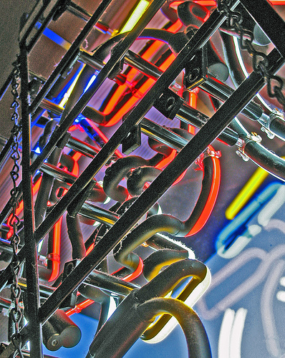
Frameworks

Slide 39
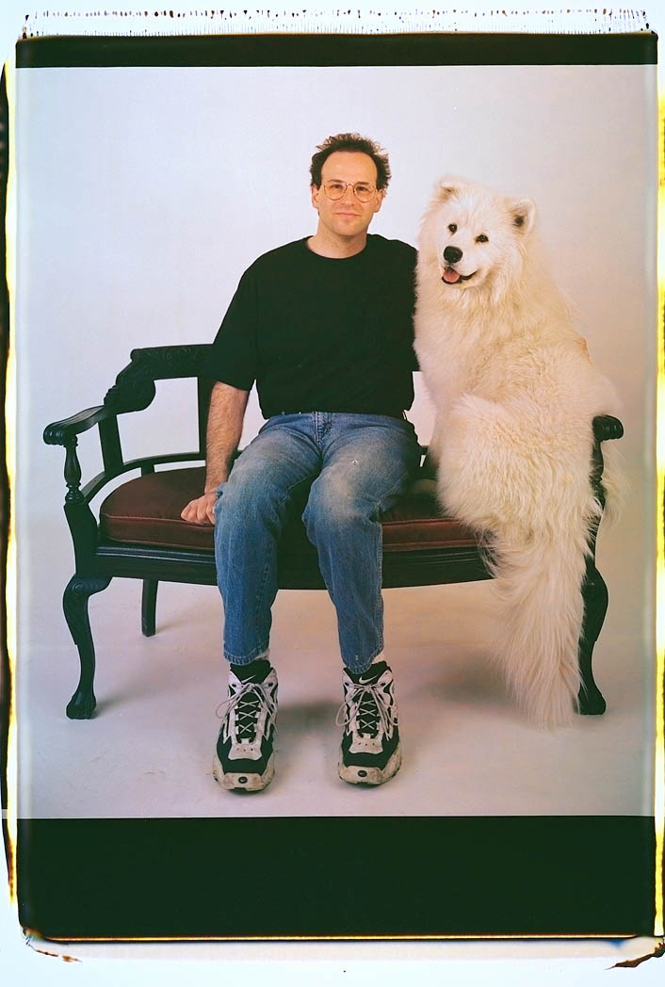
Web Application Frameworks

Slide 40
Web Application Servers
Deploy Web Applications
Pile of Parts
Dozens of Choices
Indecision Breeds Religious Arguments

Slide 41
ADMIN
INTERFACE
CACHE
WEB
SERVER
URL REWRITE
SECURITY
PYTHON
TESTING
TEMPLATE
ENGINE
AJAX
MIGRATION
OBJECT/RELATIONAL MAPPING
USER
IDENTITY
DATABASE

Slide 42


Slide 43
Zope
Scalable Since 1995
Full web based interface
Zope 2 and Zope 3
Success is its own reward

Slide 44
ADMIN
INTERFACE
CACHE
WEB
SERVER
URL REWRITE
SECURITY
PYTHON
TESTING
TEMPLATE
ENGINE
AJAX
MIGRATION
OBJECT/RELATIONAL MAPPING
USER
IDENTITY
DATABASE

Slide 45
ADMIN
INTERFACE
CACHE
WEB
SERVER
URL REWRITE
SECURITY
PYTHON
TESTING
TEMPLATE
ENGINE
AJAX
MIGRATION
OBJECT/RELATIONAL MAPPING
USER
IDENTITY
DATABASE

Slide 46


Slide 47
Django
Emphasis on Don't Repeat Yourself (DRY)
Interactive console
Unfortunate naming, e.g., MVC
Confusion Comes From Names

Slide 48
ADMIN
INTERFACE
CACHE
WEB
SERVER
URL REWRITE
SECURITY
PYTHON
TESTING
TEMPLATE
ENGINE
AJAX
MIGRATION
OBJECT/RELATIONAL MAPPING
USER
IDENTITY
DATABASE

Slide 49

APACHE,
MOD_PYTHON,
ETC.
ADMIN
INTERFACE
CACHE
WEB
SERVER
URL REWRITE
SECURITY
PYTHON
TESTING
TEMPLATE
ENGINE
AJAX
MIGRATION
OBJECT/RELATIONAL MAPPING
USER
IDENTITY
DATABASE

Slide 50


Slide 51
TurboGears
Assembled from more parts
More screencasts
Still fairly young
Outreach Makes People Happy

Slide 52


ADMIN
INTERFACE
CACHE
WEB
SERVER
URL REWRITE
SECURITY
PYTHON
TESTING
TEMPLATE
ENGINE
AJAX
KID
MIGRATION
OBJECT/RELATIONAL MAPPING
SQLObject
USER
IDENTITY
DATABASE

Slide 53

Pylons

Slide 54
Pylons
Reimplements Ruby on Rails
Lots of Code Generators
Flexibly Assembled with Python Paste
Flexibility has its limits

Slide 55
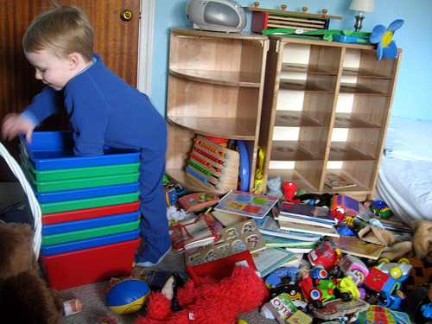
Content
Management
Systems

Slide 56
Content Management Systems
Web Site Publishing
On top of Web Application Servers
One Serious Choice
Great When It Just Works!

Slide 57


Slide 58
Plone
Built on Zope
Strong Support Base
Archetypes and Extendable Content Types
Right Design Helps a Lot

Slide 59
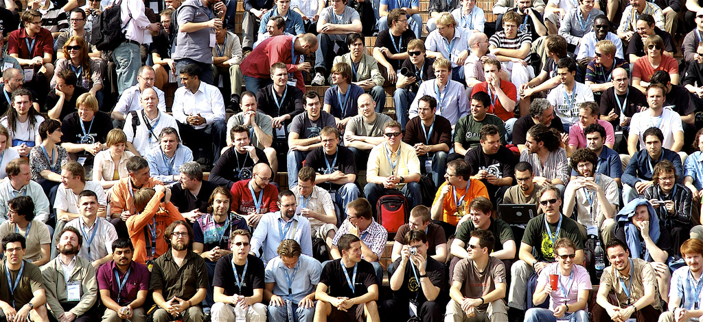
Plone

Slide 60
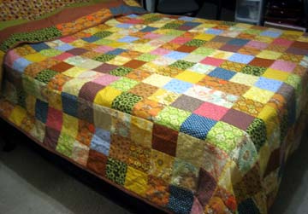
Finished!

Slide 61
Summary
Keep Exploring Python
Wikipedia is Your Friend
Ignore Version Numbers
Learn until you are dead and buried.

Slide 62
Summary
Charles Merriam
Phone: 408.368.6050
Email: charles.merriam@gmail.com
Blog: charlesmerriam.com/blog
Slides and Notes: charlesmerriam.com/talk

